Slide 1
The Mean Squares
Alternus-Vera

Slide 2
Agenda
Overview
Neural Micro-Patterns-Of-MisInformation [by Jeyasri]
News Coverage [by Subarna]
Bias [by Wasae]
Credibility and Reliability [by Pranav]

Slide 3
Overview
With the increase of technology, smartphones, tablets, laptop, wireless internet connection. We have seen an explosion of information being passed around.
Some of this information is news articles, these articles can be true or they can be misleading.
We wanted to help design a tool that would allow a user to determine if an article was misleading based on the content, the author, the source, and many other factors.

Slide 4
Factor 1: NEURAL MICRO-PATTERNS-OF-MISINFORMATION
Misinformation: Information that is false but not created with the intention of causing harm
AI powered models such as openAI’s GPT-2 model, Google’s Glove3D and Grover by AllenNLP tools develop fake news which follows a common pattern which can be understandable by AI powered network than human.
The major part of this analysis is investigating the micro-patterns present in the fake news data in comparison to real data.
This investigation is done using ISOT dataset for the equal volume of True and Fake dataset of 23K and 21K articles

Slide 5
Factor 1: NEURAL MICRO-PATTERNS-OF-MISINFORMATION
Approach
Auto-Encoder to detect anomaly in data
N-gram model to detect patterns in data
LDA modeling to distill fine-grain information in data
Doc2Vec embedding
Sentiment analysis

Slide 6
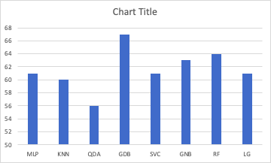
Factor 1: NEURAL MICRO-PATTERNS-OF-MISINFORMATION
From the vectors of each news article, predict the real Versus fake news (as a binary classification modeling)
Below are the accuracy from various binary classifiers

Slide 7
Factor 1: NEURAL MICRO-PATTERNS-OF-MISINFORMATION
Amalgamation with Liar Liar dataset for Multi-label classification
Amalgamation of Liar Liar Dataset and ISOT dataset is verified with KNN Classifier and Distance similarity.
Since ISOT dataset doesn’t have much features like Liar Liar dataset and the articles corpus are not close to each other .
The Amalgamation is tried with LDA topics as well but the results are not accurate.

Slide 8
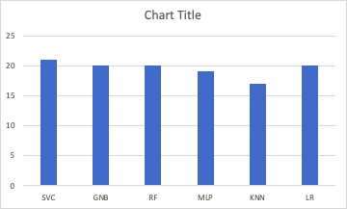
Factor 1: NEURAL MICRO-PATTERNS-OF-MISINFORMATION
The similar approach was applied to classify multi-label of LiarLiar dataset such as True, mostly true,half true, barely true, false,pants on fire.
Below are the accuracy of the model from Multi-label classification.

Slide 9
Factor 1: NEURAL MICRO-PATTERNS-OF-MISINFORMATION
Conclusion
The performance of the multi-label classification is worse compared to binary classification.
Liar Liar dataset has very few records and true labels are less compared to Fake labels.
Having a high volume dataset with multi class would help to improve the performance of model

Slide 10
NEWS COVERAGE
News Coverage: Coverage of the same topic/story in different media outlets
Dataset:
Kaggle All News [50000 rows]
Fake News [13000 rows]
Liar Liar
Approaches:
Data Loading/ Cleaning/ Analysis
Distillation
Data Enrichment + Amalgamation
LDA Topic Modeling
Sentiment Analysis
Computing News Coverage Score
Using Score to detect fake news [multiclass classification]
Models:
News coverage score computation model
Fake news detection model [Random Forest]

Slide 11
Bias
Toxicity Dataset
Dataset -> LDA -> Antonyms
Biased and Unbiased Label dataset -> LDA -> Cosine Similarity
Improvements:
Better LDA/Tf-Idf
Incorporating toxicity dataset

Slide 12
Credibility and Reliability
Determine information about the Source
List of website and their classification (FakeNewsCorpus)
Website Rank and Page Rank Score (OpenPageRank)

Slide 13
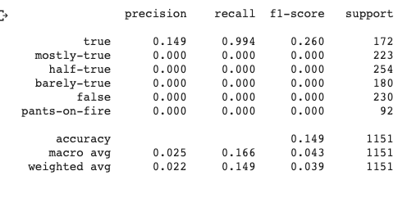
Final Model
Equation: (0.67 * Micro Pattern) +(0.88 * New Coverage) + (0.5* Bias Feature) + (0.6*Credibility & Reliability)
The above equation is derived from all team members factors.
The final multi- class classification model is measured with accuracy 14.9%.
Below is the classification report for each label

Slide 14
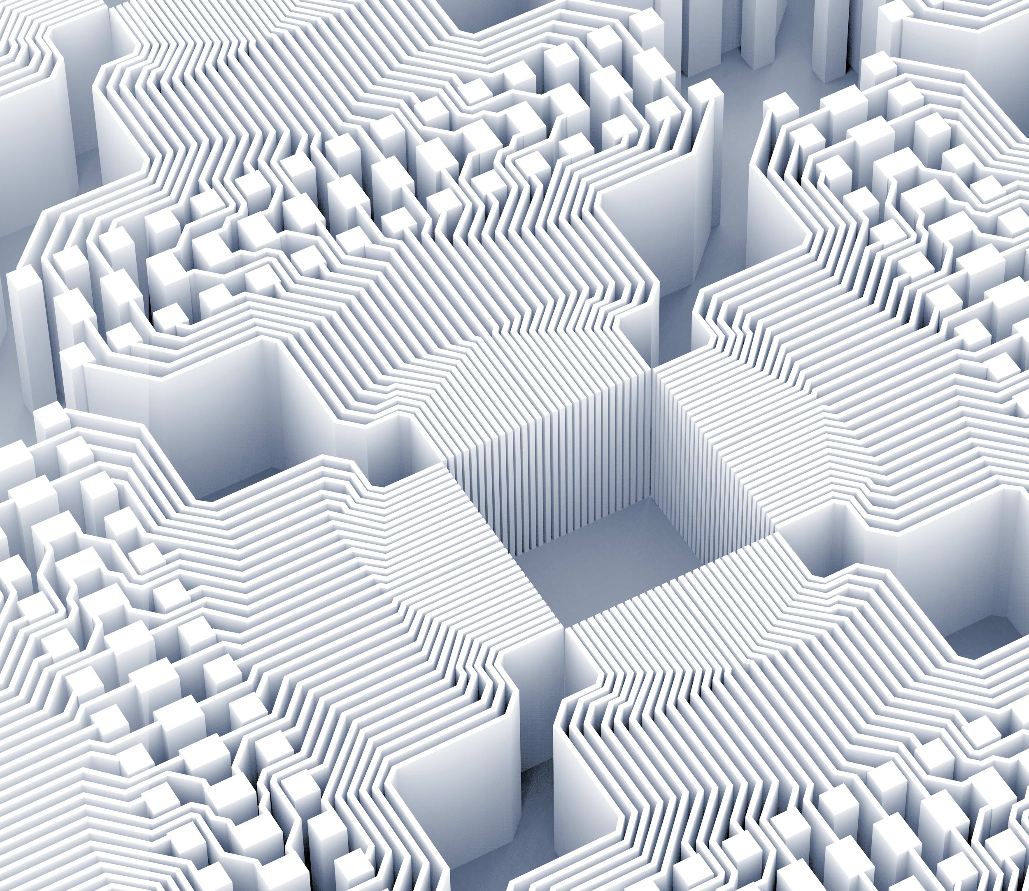
Thank you!

